Slide 1


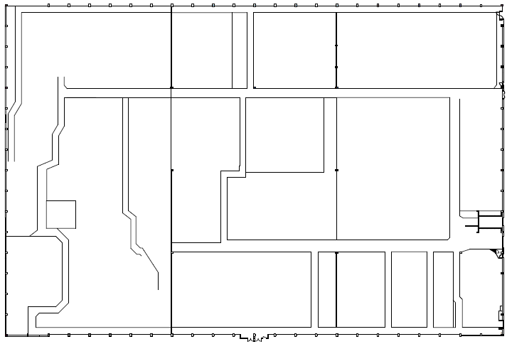
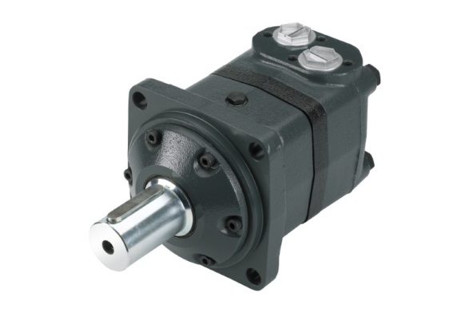
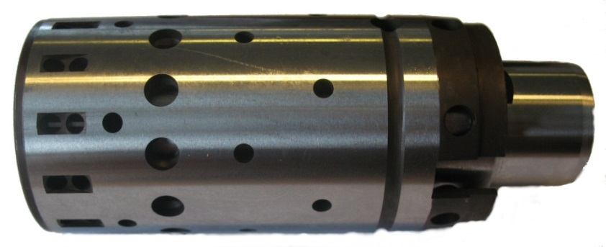
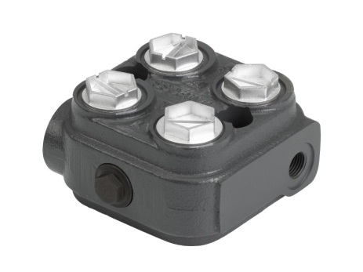
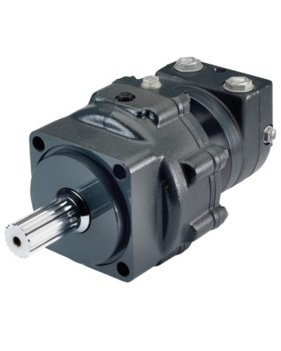
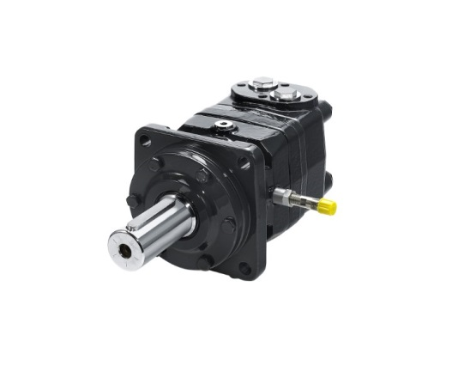
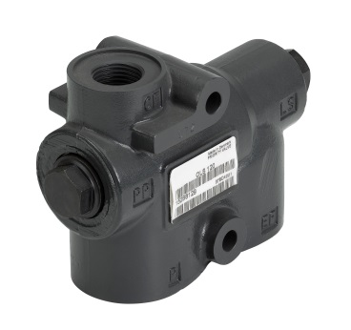
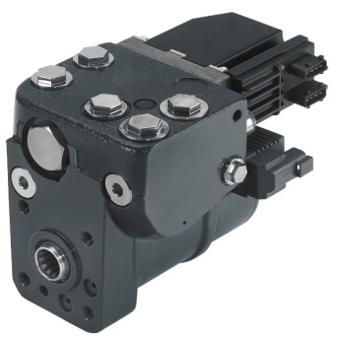

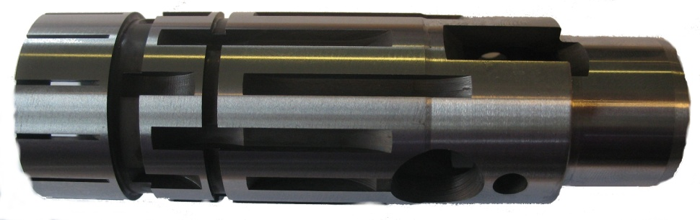
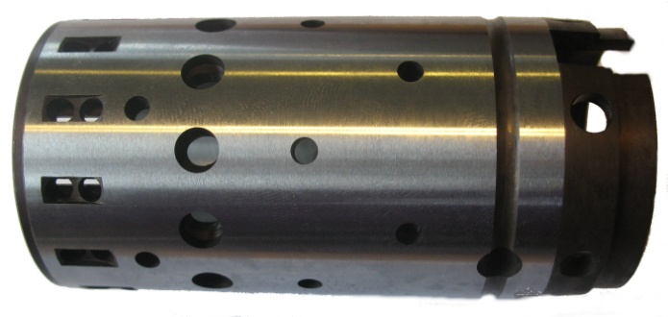
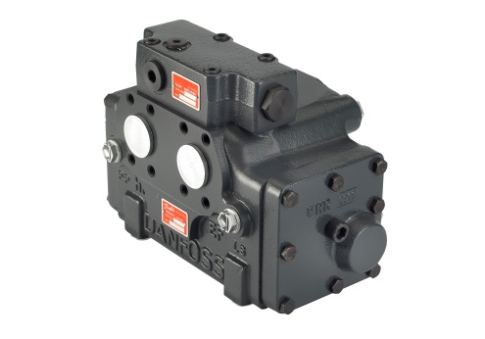
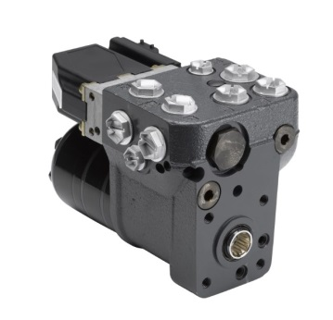
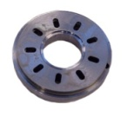
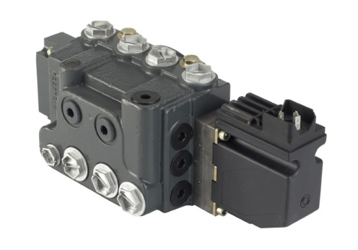
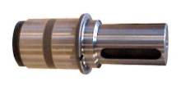
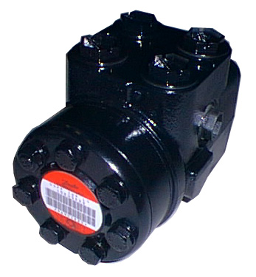
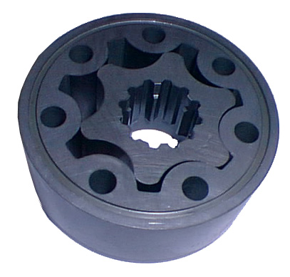
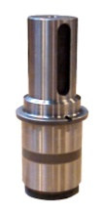
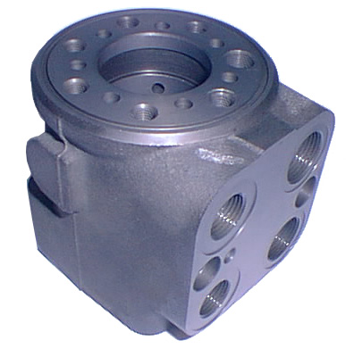
PRODUCTION L4
Quality Assurance
Steering
Assembly/Test EHI
Steering
Supermarket
Motors
Assembly/Test
OMT-F
Maintenance
Steering
Spool-set
Grinding
Main-
tenance
Motors
Assembly/Test OMV
Steering
Ship end of line OSP
Motors
Assembly/Test OMT
Motors
Assembly/Test TMT/K/H
Steering
Supermarket
Steering
Spool-set
Machining
Motors
Supermarket
Motors
End-Cover/Housing -Machining
Steering
Painting
Steering
Assembly Valves
Steering
Manganese Phosphating
Motors/Steering
Manganese Phosphating
Motors
Shaft
Soft Machining
Steering
LAB
Steering
Assembly/Test OSP
Steering
Housing Machining
Steering
Gear-set
Grinding
Motors
Motor Parts Grinding
Entrance

